Slide 1


Rohan Ballapragada
December 8th 2023

Slide 2

Outline
Executive Summary
Introduction
Methodology
Results
Conclusion
Appendix

Slide 3
Executive Summary
- Data Collection via API
- Data Collection via Wikipedia
- Data Wrangling filling null values
- EDA with Data Visualization
- EDA with SQL
- Building interactive map with Folium
- Building a dashboard with Plotly
- Predictive Analytics

Slide 4
Introduction
Project background and context
SpaceX has demonstrated to be the largest customer for both public and private enterprises in space travel. They have shown their successes in ventures like sending spacecraft to the space station, their starlink internet constellation, and sending manned missions to the International Space Station. The reason as to why most enterprises seek them out is their ability to launch their rockets cost effectively, a SpaceX falcon 9 rocket costs $62 million dollars whereas rockets from other providers cost $165 million dollars, that is due to their ability to recover and reuse the first stage. If we can determine if the first stage can land, we can determine the cost of the launch. This information can be used if another company wants to compete against SpaceX.
Problems you want to find answers
What are the defining factors in a successful Stage 1 landing?
What sort of conditions do we need to place the Falcon 9 so we get a successful Stage 1 landing?

Slide 5

Section 1

Slide 6
Methodology
Executive Summary
Data collection methodology:
How data was collected
Perform data wrangling
How data was processed
Perform exploratory data analysis (EDA) using visualization and SQL
Perform interactive visual analytics using Folium and Plotly Dash
Perform predictive analysis using classification models
How to build, tune, evaluate classification models

Slide 7
Data Collection
Describe how data sets were collected.
Data was collected through an API call from the spacexdata.com website
We next decode the response to a JSON using.json() and turn it into a Pandas dataframe using .json_normalize
Get information for the dataframe that we would need like BoosterVersion, PayloadMass, and Outcome
Filter the dataframe to only include Falcon 9 launches and filled in missing values
Continued to scrape data from Wikipedia for Falcon 9 launchs with BeatifulSoup.

Slide 8
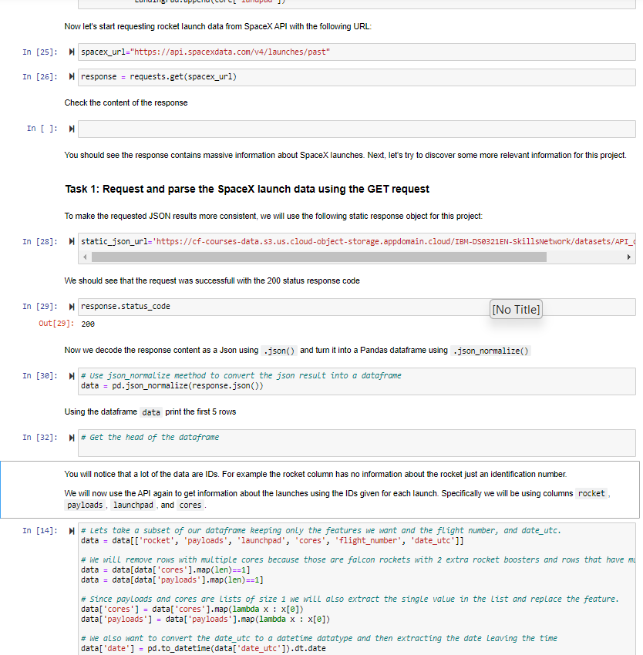
Data Collection – SpaceX API
Utilized the get request to the SpaceX API for data collection, cleansing, and formatting.
https://github.com/ballaprr/IBM_FinalProject_DSAppliedCapstone/blob/main/Week_1/.ipynb_checkpoints/jupyter-labs-spacex-data-collection-api-checkpoint.ipynb

Slide 9
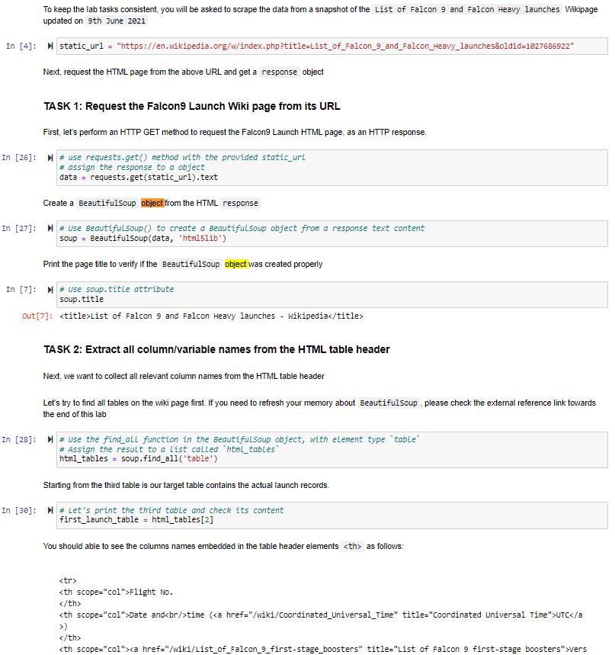
Data Collection - Scraping
Used web scraping to Falcon 9 launch data with BeatifulSoup
https://github.com/ballaprr/IBM_FinalProject_DSAppliedCapstone/blob/main/Week_1/.ipynb_checkpoints/jupyter-labs-webscraping-checkpoint.ipynb

Slide 10
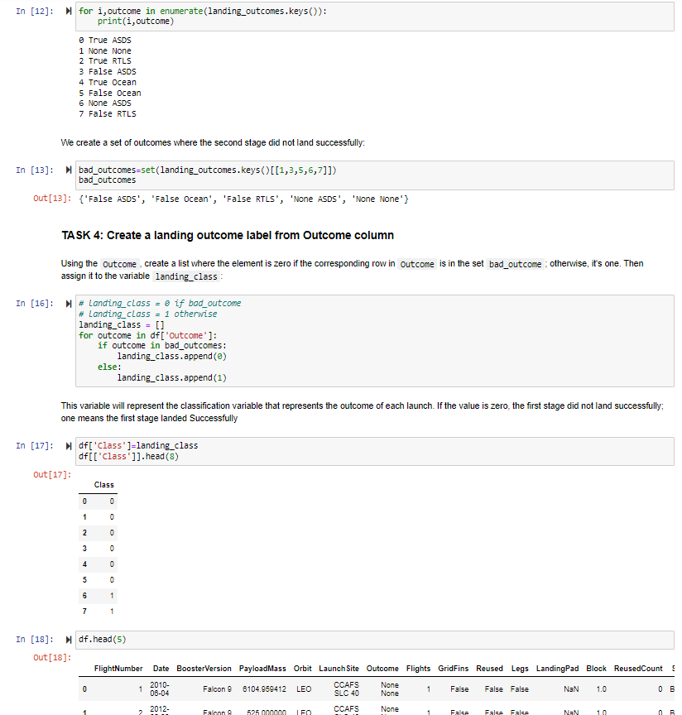
Data Wrangling
Checked the null values from the SpaceX dataset
Looked into the amount of missing values for each feature and the types
Looked at the different and amount of mission outcomes
Created a binary based landing outcome where all bad outcomes are set to zero and good to one
https://github.com/ballaprr/IBM_FinalProject_DSAppliedCapstone/blob/main/Week_1/.ipynb_checkpoints/labs-jupyter-spacex-Data%20wrangling-checkpoint.ipynb

Slide 11
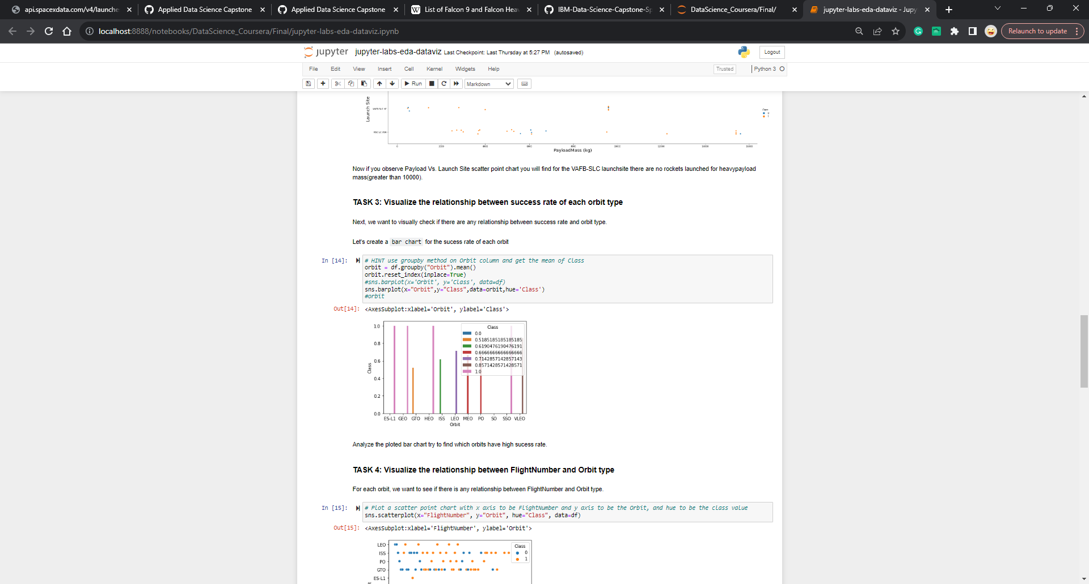
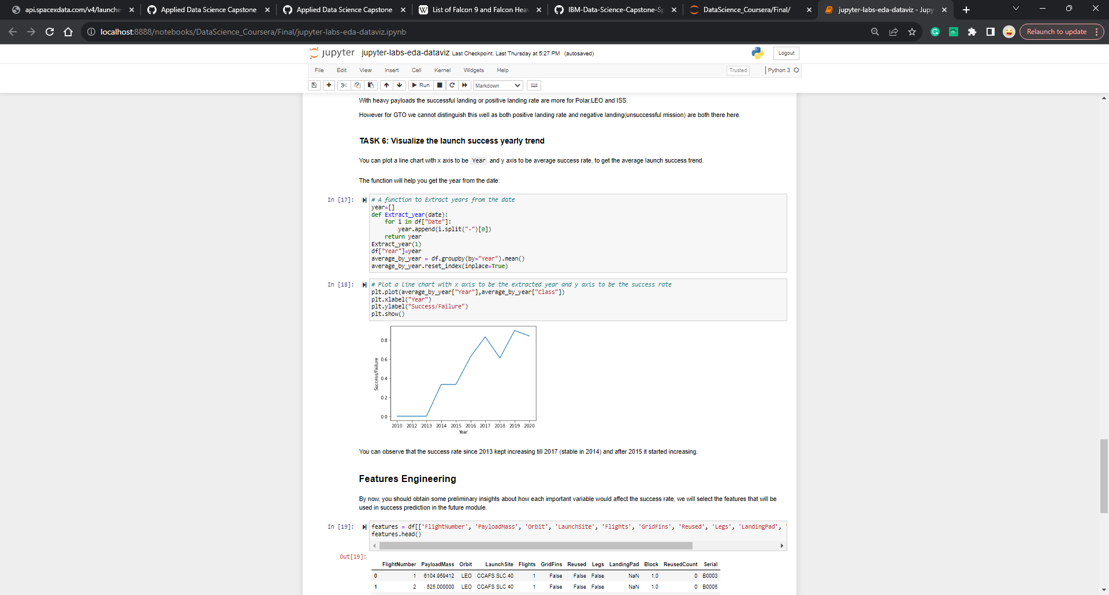
EDA with Data Visualization
The graph on the bottom right shows the success/failure rate of each Falcon 9 launch from 2010 onwards, the success rate continually trending upwards. The graph on the left shows the success rate for each orbit type.
https://github.com/ballaprr/IBM_FinalProject_DSAppliedCapstone/blob/main/Week_2/jupyter-labs-eda-dataviz.ipynb

Slide 12
EDA with SQL
Some of the following SQL queries I have written:
Names of the unique launch sites in the space mission
5 records where launch sites begin starting with the string ‘CCA’
Total payload launch by NASA (CRS) and average payload by booster version F9 v1.1
Date of the first successful landing outcome in ground pad was achieves
Names of boosters which have success in drone ship and payload between 4000 and 6000
Rank the count of landing outcomes (Failure (drone ship) or Success (ground pad)) between 2010-06-04 and 2017-03-20 in descending order
https://github.com/ballaprr/IBM_FinalProject_DSAppliedCapstone/blob/main/Week_2/jupyter-labs-eda-sql-coursera_sqllite.ipynb

Slide 13
Build an Interactive Map with Folium
On the folium map are marked coordinates for the Launch Sites. The success/failed launch attempts, and the distances between each launch site proximity.
The markers are colored so we know which launch sites had the most or least successful launches.
https://github.com/ballaprr/IBM_FinalProject_DSAppliedCapstone/blob/main/Week_3/lab_jupyter_launch_site_location.ipynb

Slide 14
Build a Dashboard with Plotly Dash
On the plotly interactive dashboard there is a pie chart on each of the SpaceX sites and there is a scatter plot showing the relationship between the payload mass and the success.
These plots were added to determine how successful each of the orbital launch sites are how much the payload had to do with it.
https://github.com/ballaprr/IBM_FinalProject_DSAppliedCapstone/blob/main/Week_3/spacex_dash_app.py

Slide 15
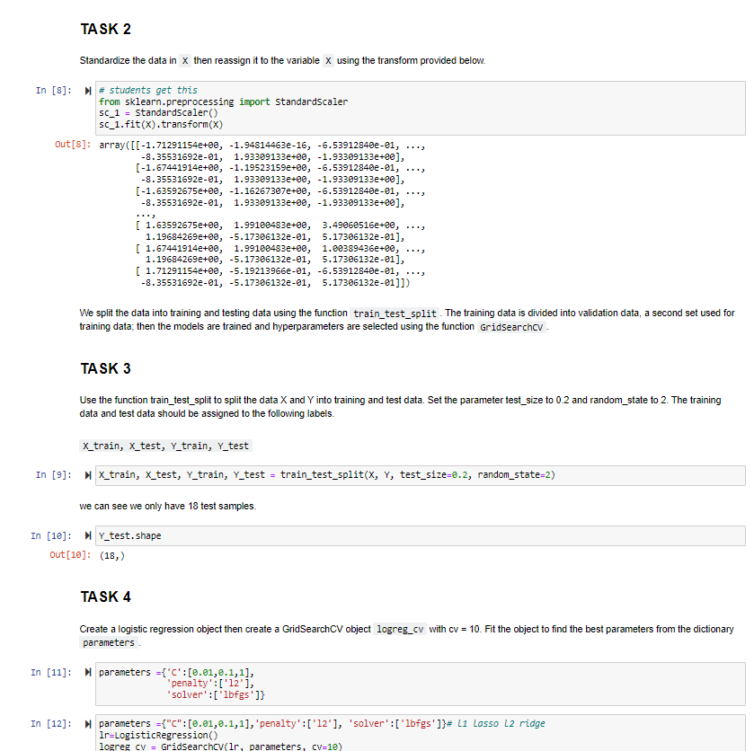
Predictive Analysis (Classification)
I imported the desired libraries, pandas, numpy, and sickit-learn, loaded the data, standardized the data, split into train/test splits.
Built different machine learning models and tuned to different hyperparameters using GridSearchCV
Used accuracy as our metric to test the models
Add the GitHub URL of your completed predictive analysis lab, as an external reference and peer-review purpose

Slide 16
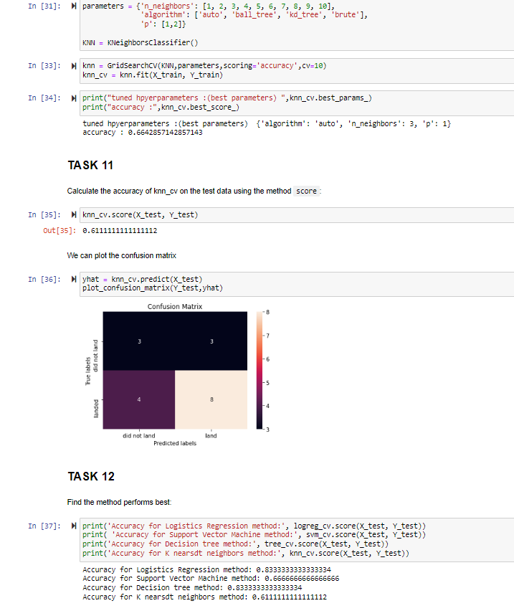
Results
When looking at the different models:
Logistics Regression
Support Vector Machines
Decision Tree
K nearest neighbor
The Decision tree is giving the best fit model

Slide 17

Section 2

Slide 18
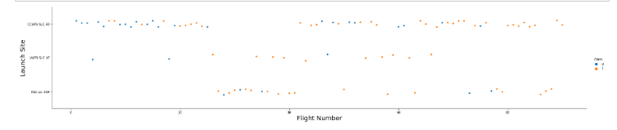
Flight Number vs. Launch Site
The more flights the higher the success rate

Slide 19
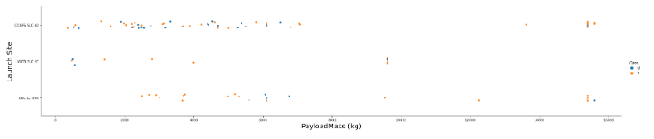
Payload vs. Launch Site
The success between the launch and its payload are not correlated

Slide 20
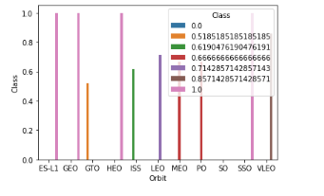
Success Rate vs. Orbit Type
The bar chart demonstrates the success rate for each orbit. The following are ES-L1, GEO, HEO, and SSO.

Slide 21
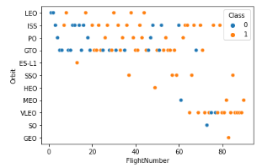
Flight Number vs. Orbit Type
Based off our findings from the plot there is higher success for more flights in each orbit with the exception of GTO.

Slide 22
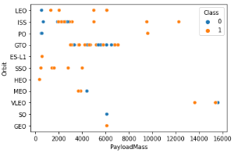
Payload vs. Orbit Type
Looking at the graph, there isn’t a correlation between the orbit and the payload mass no matter the orbit.
There will need to be more launches with a high payload

Slide 23
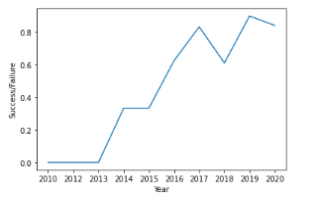
Launch Success Yearly Trend
As the years trend higher, the success rate grows.

Slide 24
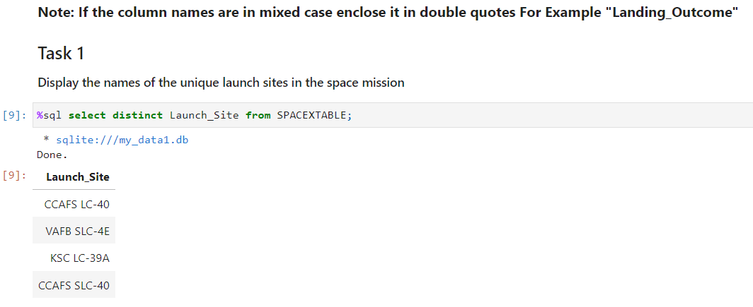
All Launch Site Names
I used the distinct keyword to obtain the unique launch sites from the table.
Displayed are the following launch sites: CCAFS LC-40, VAFB SLC-4E, KSC LC-39A, CCAFS SLC-40.

Slide 25
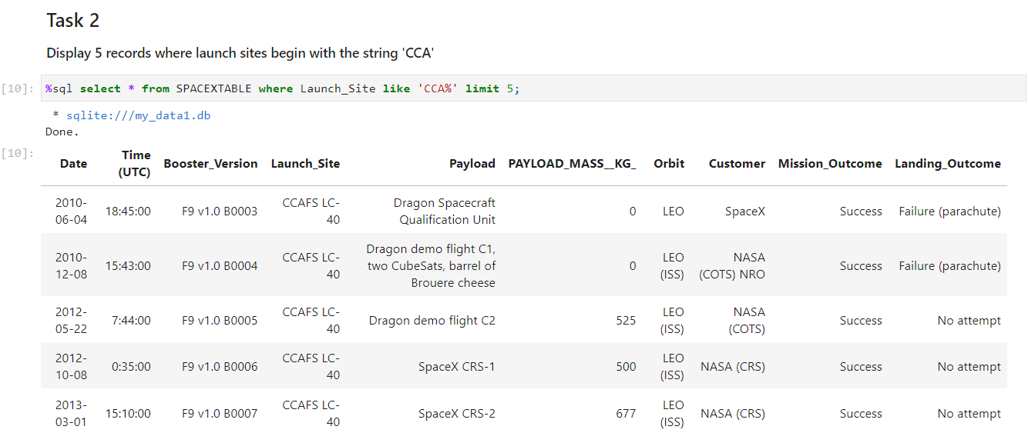
Launch Site Names Begin with 'CCA'
Used the like operator to search for a specified pattern, the Launch Site starts with “CCA” and ends with “%” to denote zero or more characters. And limit 5 to limit our query to 5 records.

Slide 26
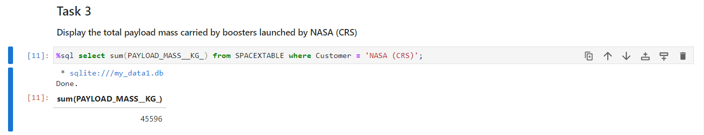
Total Payload Mass
Uses the sum query to calculate the total of the payload and the where clause to specify the launch customer.

Slide 27
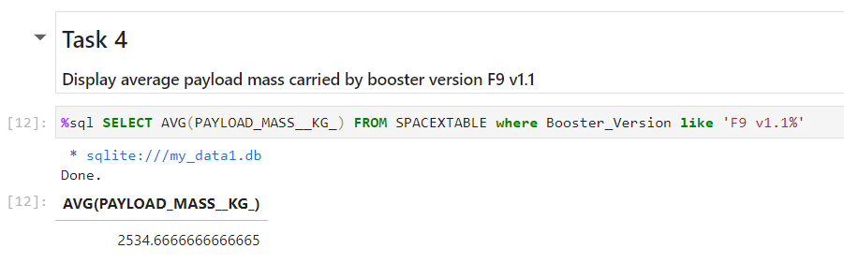
Average Payload Mass by F9 v1.1
Calculate the average payload mass carried by booster version F9 v1.1

Slide 28
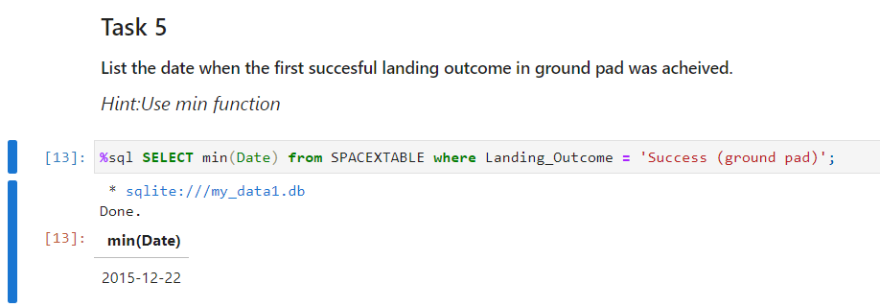
First Successful Ground Landing Date
Calculate the minimum date and use the where clause to only include the successful landings on the ground pad.

Slide 29
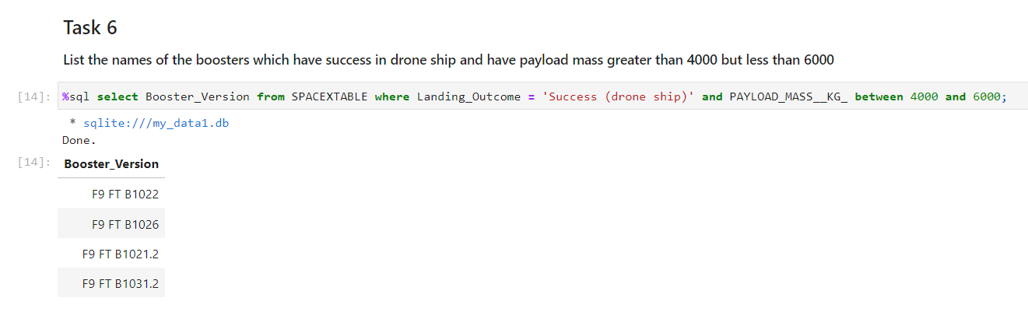
Successful Drone Ship Landing with Payload between 4000 and 6000
Uses the where clause to set the Landing Outcome to the successful first stage landings on the drone ship and the between clause to specify the boosters between 4000 and 6000.

Slide 30
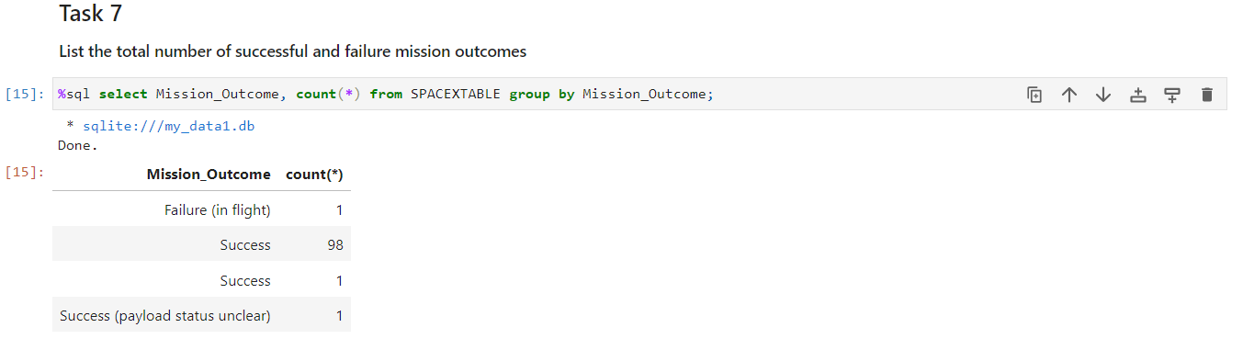
Total Number of Successful and Failure Mission Outcomes
Use the group by operator to group all the mission outcomes and the count operator to count see the number for each outcome.

Slide 31
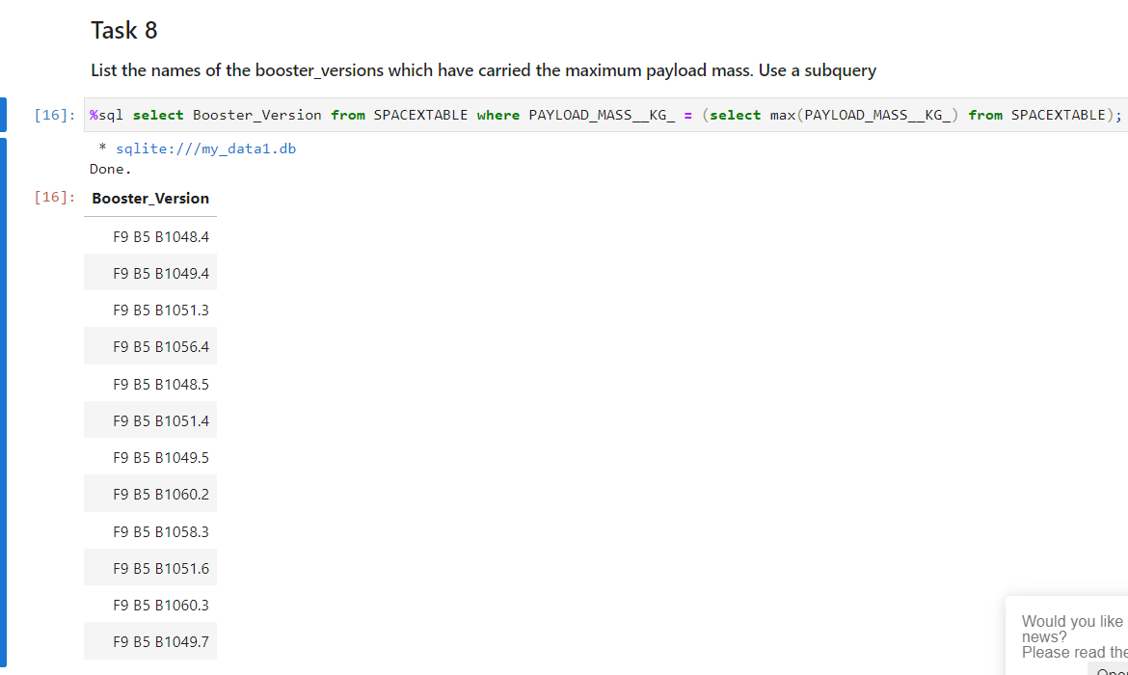
Boosters Carried Maximum Payload
Use the subquery to find the maximum payload from the table to find the corresponding Booster Version.

Slide 32
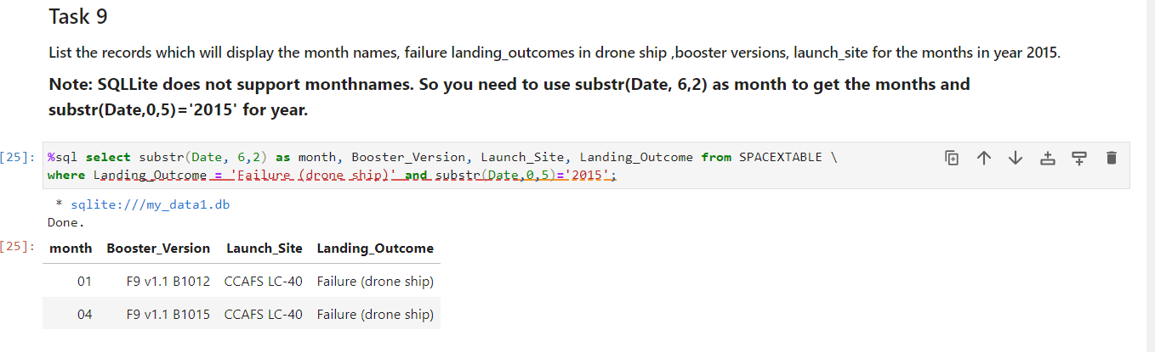
2015 Launch Records
List the failed landing_outcomes in drone ship, their booster versions, and launch site names for in year 2015

Slide 33
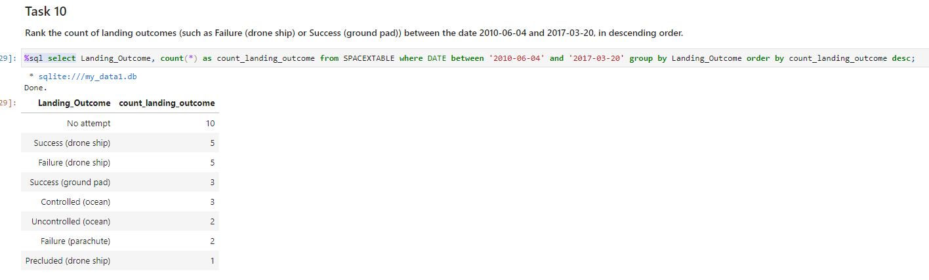
Rank Landing Outcomes Between 2010-06-04 and 2017-03-20
Selected the Landing outcomes from the data and specified the dates we want using the where clause.
Used the Group by operator to specify the landing outcome and order by to order by landing outcome in descending order

Slide 34

Section 3

Slide 35
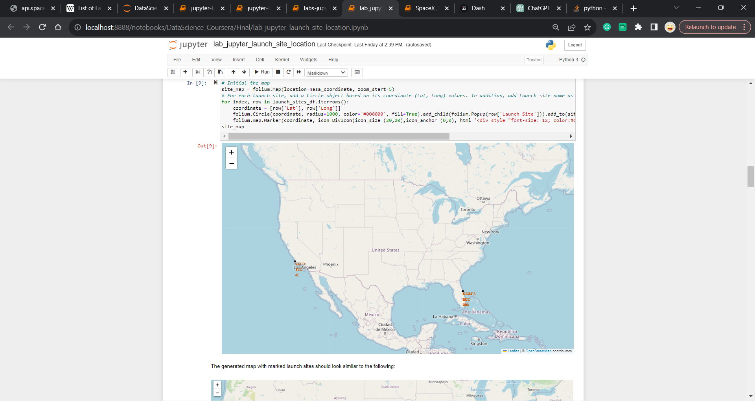
Global Launch map

Slide 36
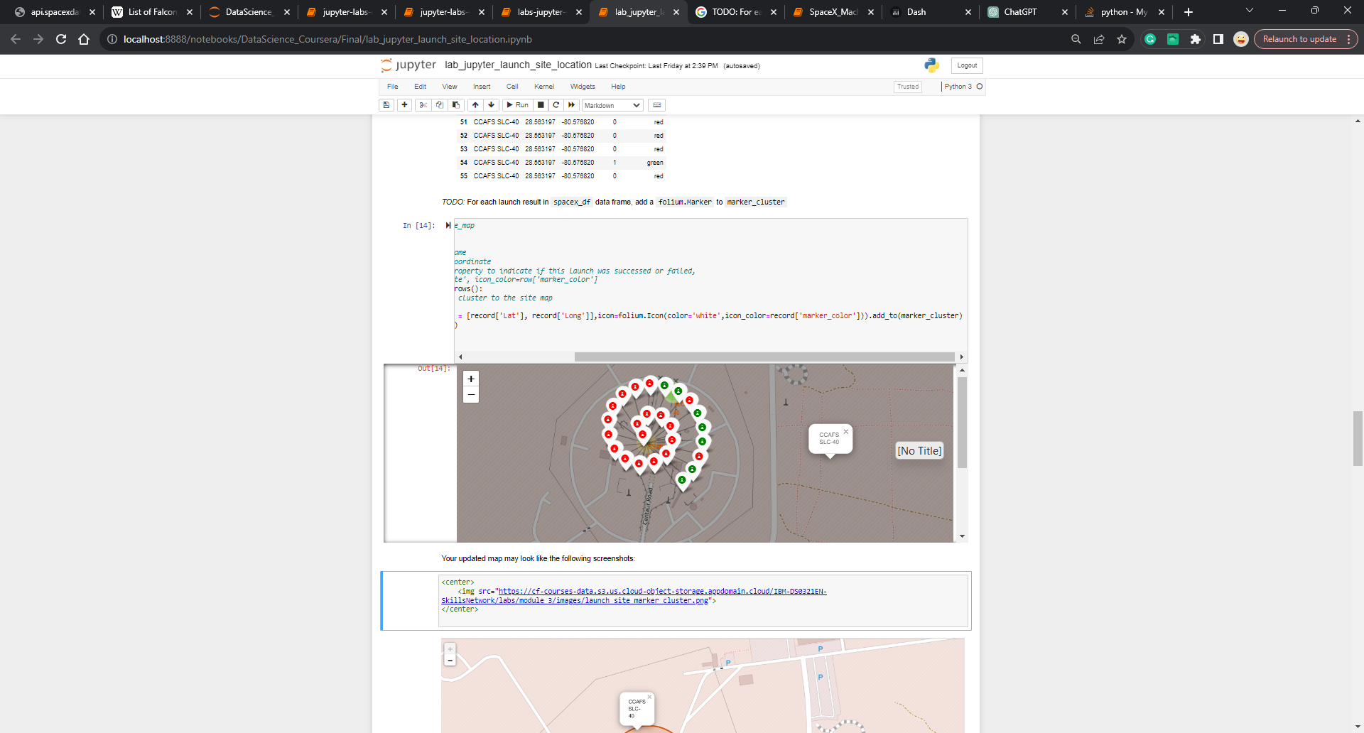

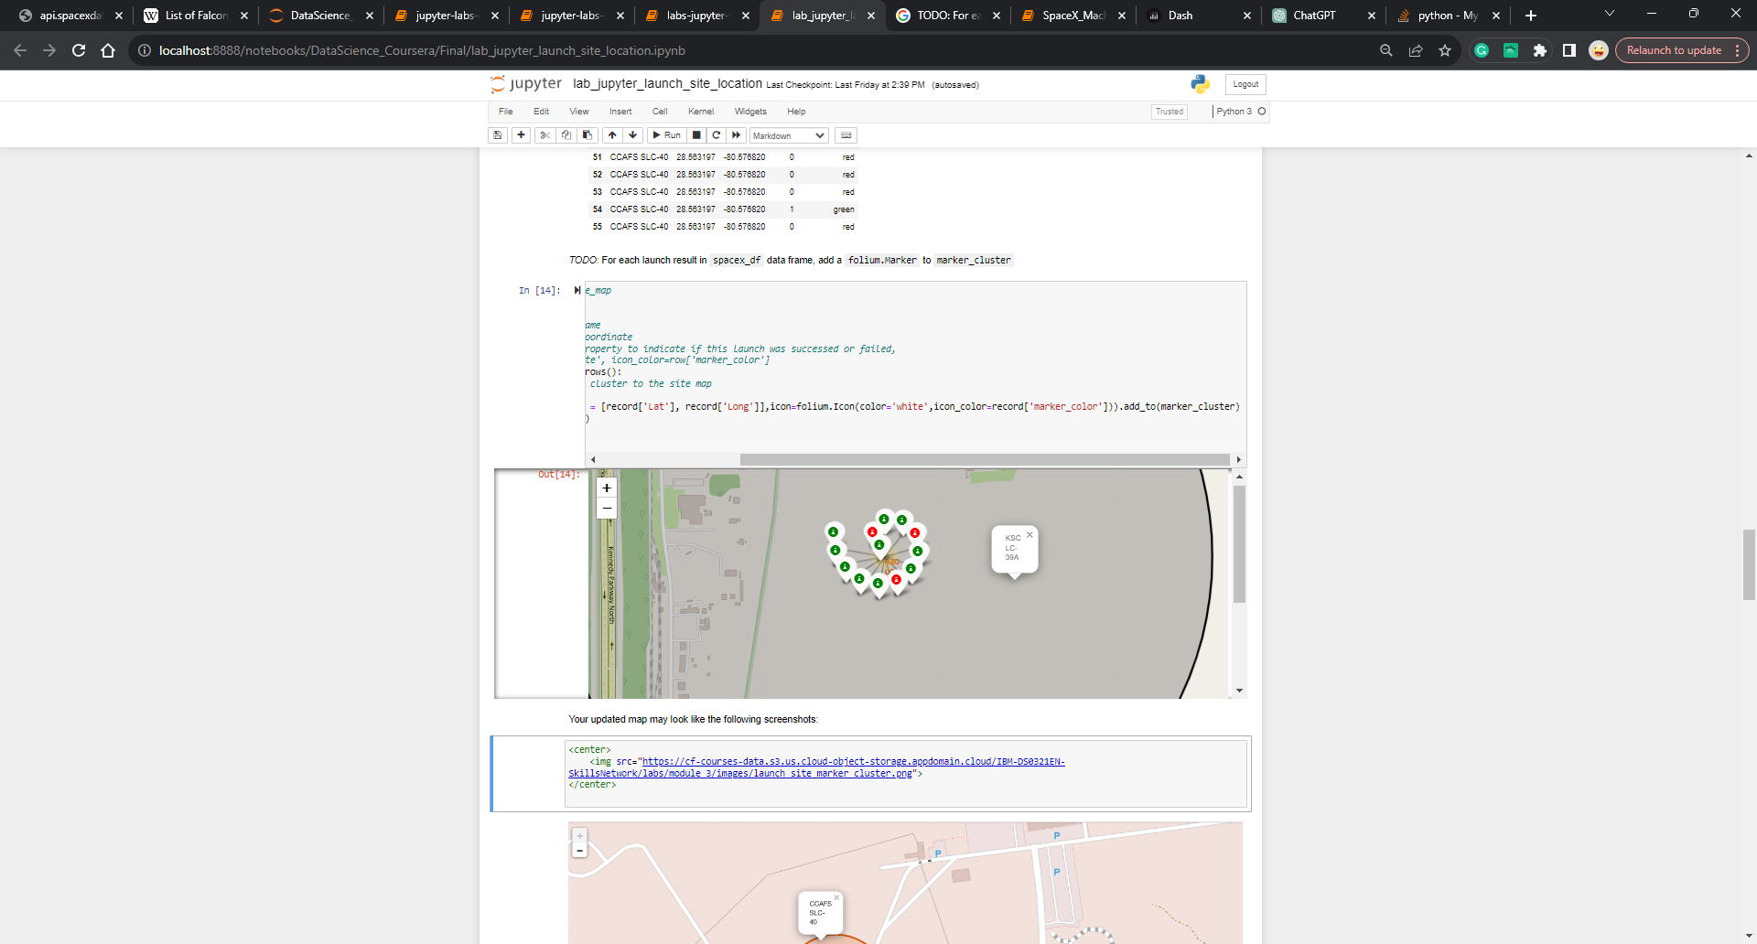
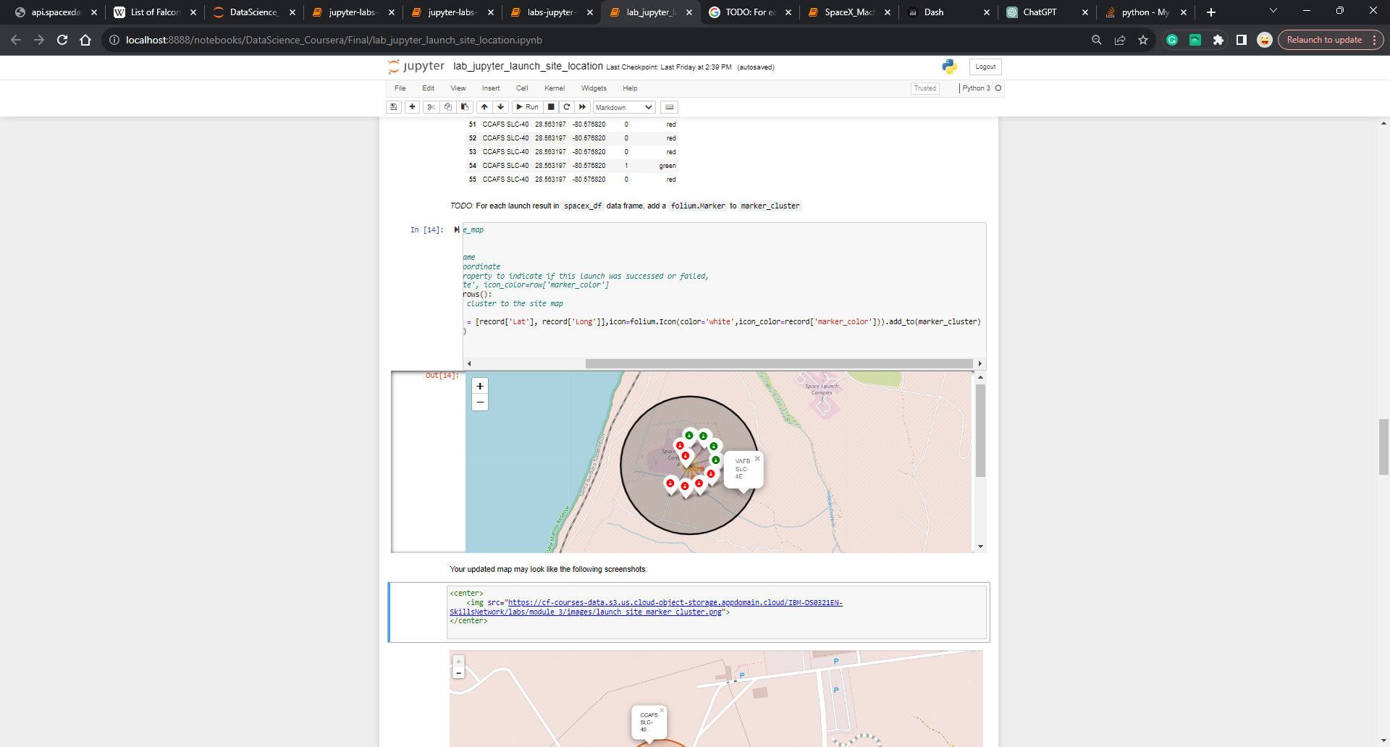
California and Florida Launches
Florida Launches:
California launches:

Slide 37
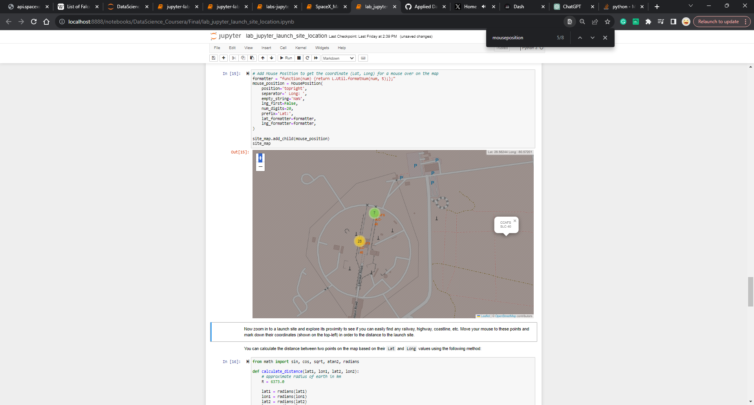
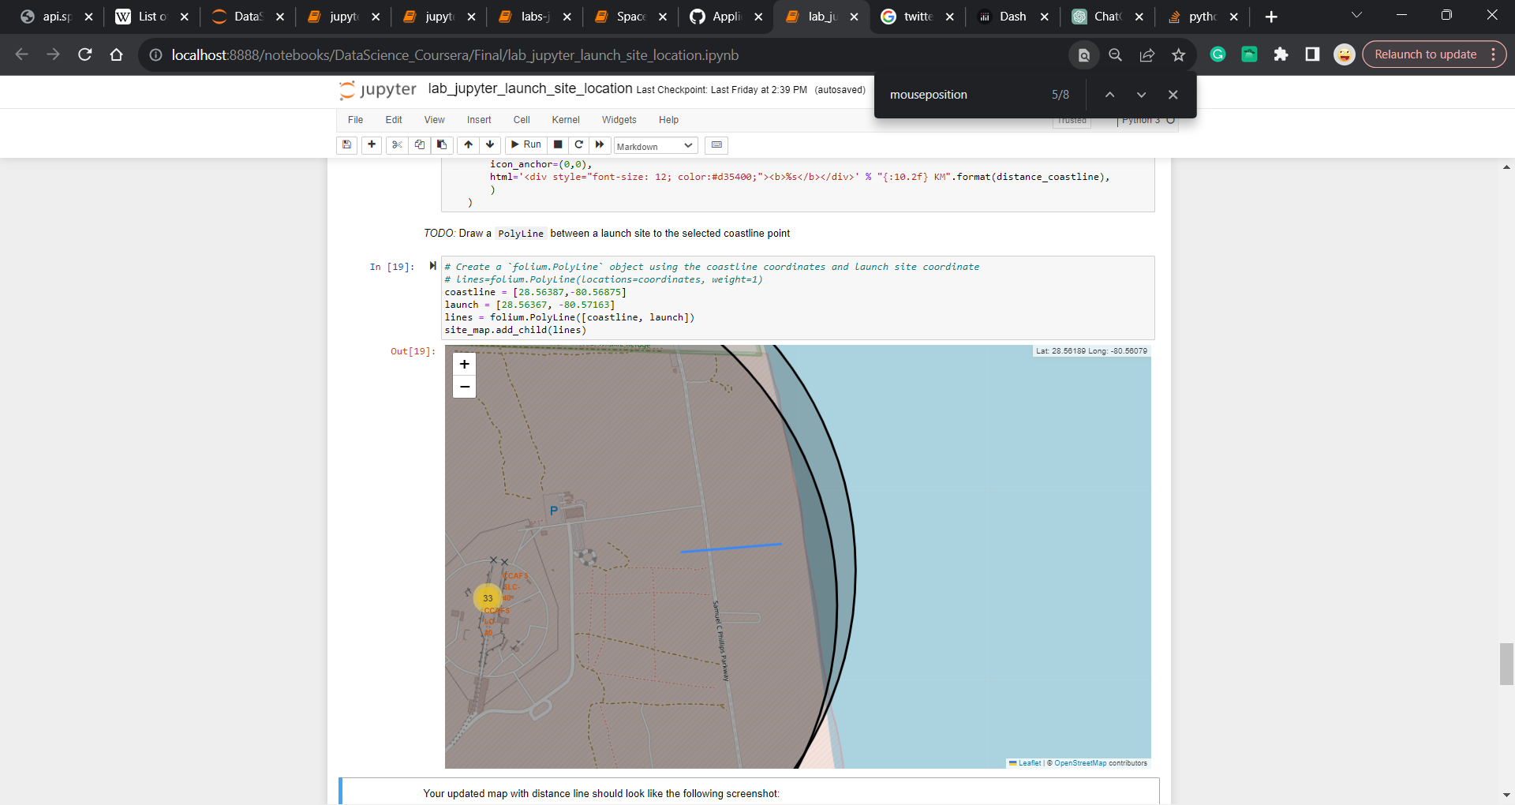
Close proximity to launch site
Close to the coastline but not near the railway, highway, nor city.

Slide 38

Section 4

Slide 39
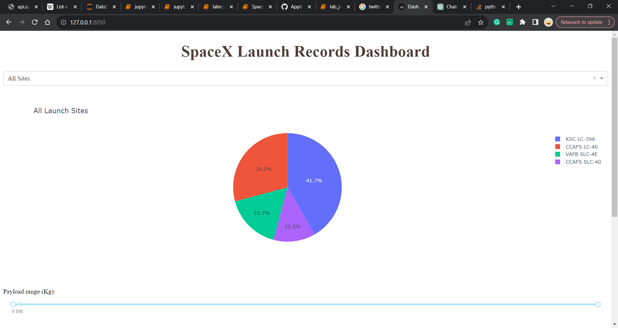
Total Successful launch sites
All successful launch sites, the KSCLA-39A had the most successful launch site

Slide 40
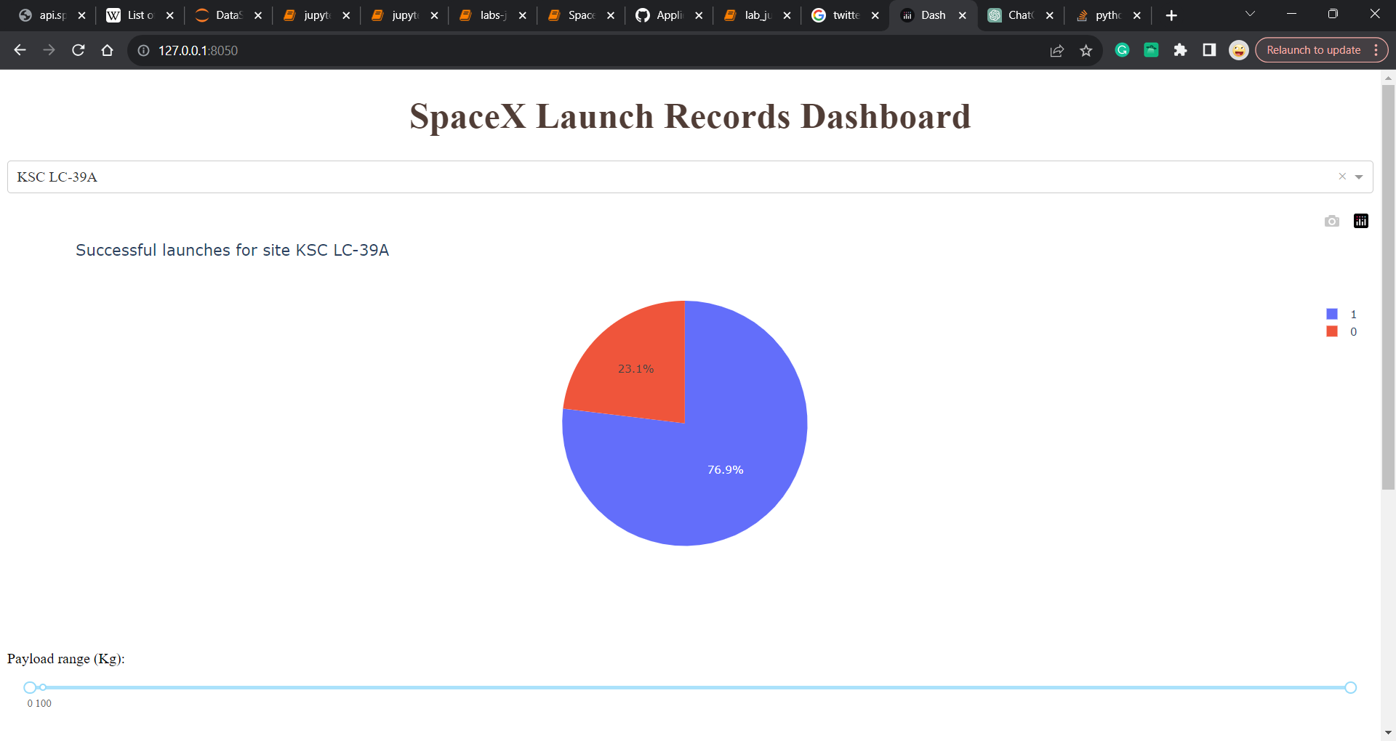
Most successful launch site
KSC LC-39A is the most successful launch site with a 76.9% rating

Slide 41
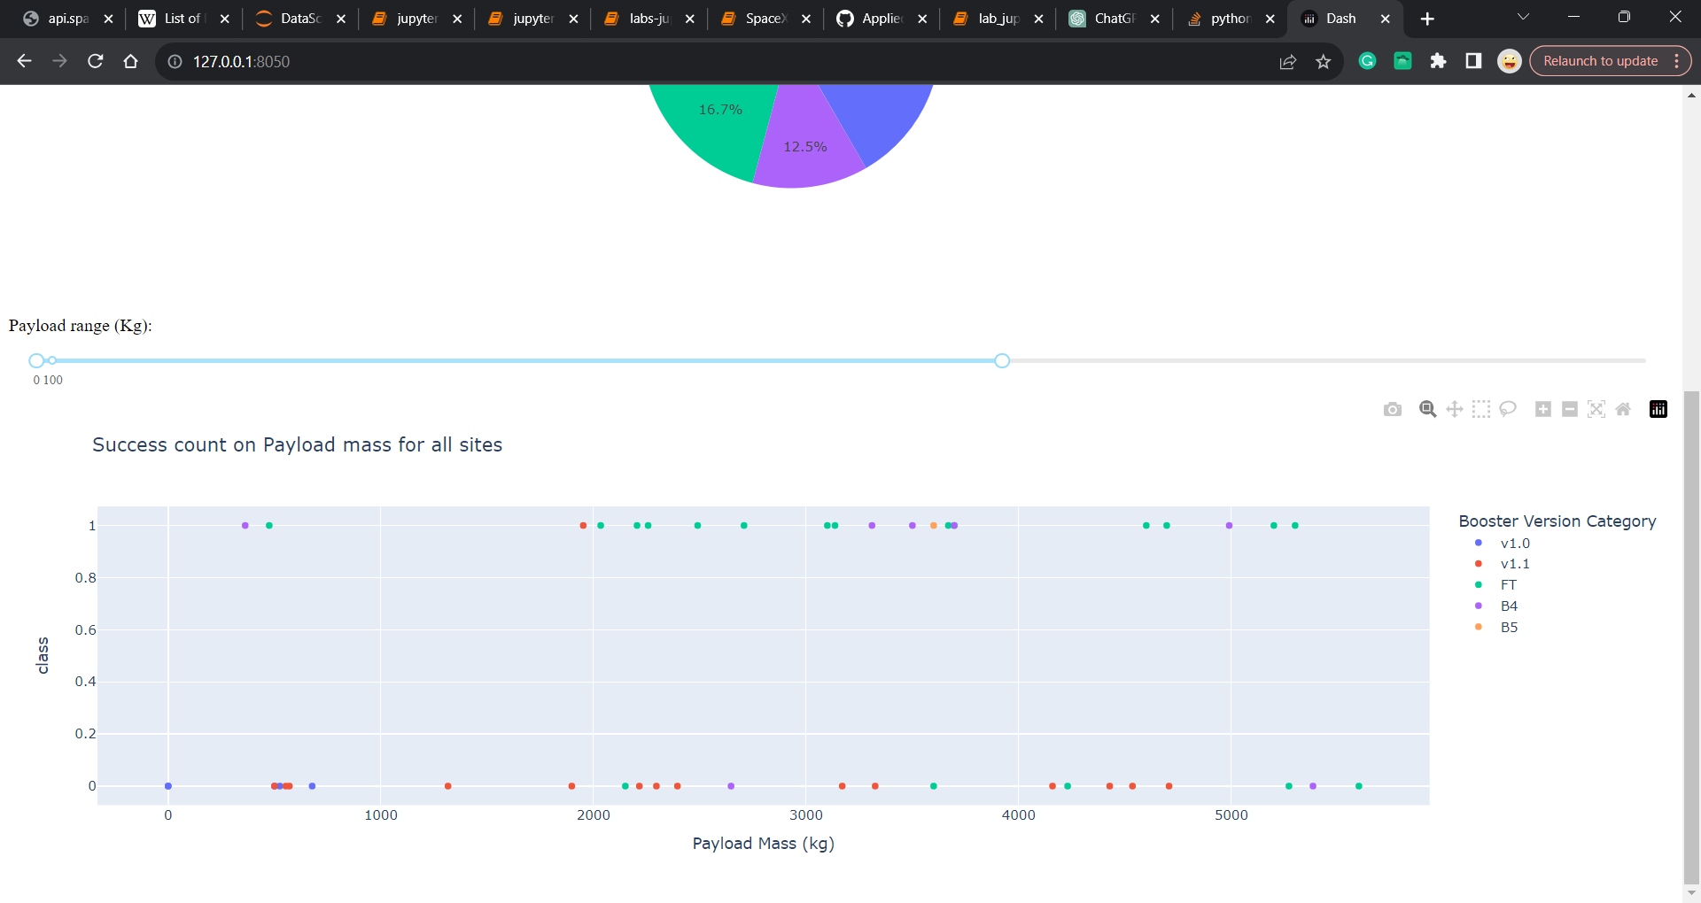
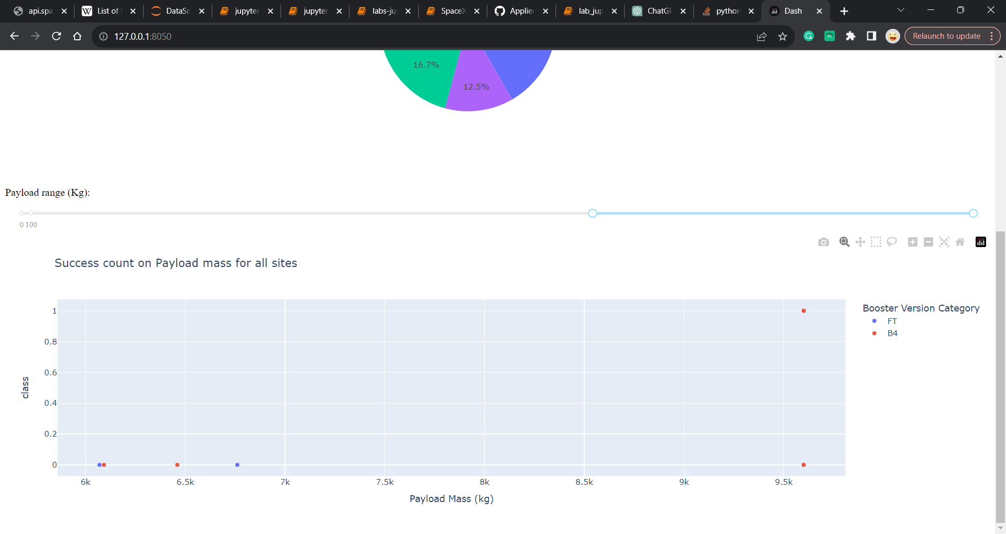
<Dashboard Screenshot 3>
The success rates between high and low payloads are nonvariable.

Slide 42

Section 5

Slide 43
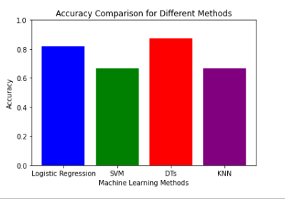
Classification Accuracy
When looking at the accuracy comparisons between the four models, the Decision Tree comes out as the best model.

Slide 44
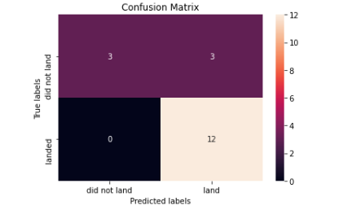
Confusion Matrix
Looking at the Confusion Matrix there are 12 True positives and 3 false negatives which is good.
There is the issue of true negatives where rockets that did not land were identified as successful.

Slide 45
Conclusions
Over time from 2013 onwards SpaceX flights get more successful over time, that includes every orbit except for GTO.
No correlation between a successful SpaceX flight and payload
The most successful landing site is KSC LC-39A
Decision Tree classifier is the best machine learning algorithm for this task

Slide 46
Appendix
https://github.com/ballaprr/IBM_FinalProject_DSAppliedCapstone/tree/main/CSV_files
Rest of data already included in slides

Slide 47


